Slide 1
أكـــــاديميــــة طــــويـــق
Linear Algebra for Machine Learning

Slide 2
Introduction to Linear Algebra
Fundamentals and Applications
By: Dr. Afshan Hashmi

Slide 3
Course Objectives:
Recall and explain the relationship between machine learning concepts and mathematical constructs like vectors and matrices.
Course Learning Outcomes:
Recognize that variations in the model parameters are vectors on the response surface - that vectors are a generic concept not limited to a physical real space
Use substitution / elimination to solve a fairly easy linear algebra problem
Understand how to add vectors and multiply by a scalar number

Slide 4
Recognizing Variations in Model Parameters as Vectors on the Response Surface
Learning Objectives
Understand the concept of a response surface.
Recognize how changes in model parameters form vectors in parameter space.
Learn that vectors are an abstract concept beyond physical space.

Slide 5

What is a Response Surface?
A response surface represents how an objective function (e.g., loss function) varies with model parameters.
Common in optimization, machine learning, and statistics.
Example: Loss function in neural network training.
Response Variable (Z-axis): This is the thing you're trying to optimize (minimize or maximize). In machine learning, this is often the loss function – a measure of how poorly your model is performing. Other examples could be the accuracy of your model
Predictor Variables (X and Y axes): These are the variables you can control that influence the response variable. In machine learning, these are the parameters of your model (e.g., the weights and biases in a neural network).
.
The Surface Itself: The surface itself represents the relationship between the predictor variables and the response variable. The shape of the surface tells you how changing the parameters affects the loss. Valleys in the surface represent areas of low loss (good performance), while peaks represent areas of high loss (poor performance).

Slide 6
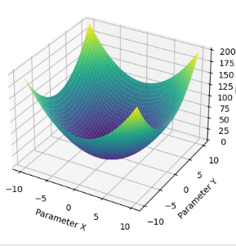
Why are Response Surfaces Important?
Response surfaces are crucial for understanding and optimizing complex systems, including machine learning models:
Visualization: They provide a visual representation of the relationship between parameters and the objective function, making it easier to understand how changes in parameters affect performance.
Optimization: By analyzing the response surface, you can identify the "best" settings for your parameters
This is what optimization algorithms like gradient descent do in machine learning.
Understanding Interactions: Response surfaces can reveal how different parameters interact with each other. For example, changing one parameter might have a different effect depending on the value of another parameter.
Loss

Slide 7
Vectors in Generic Spaces
Vectors are not limited to the familiar 2D and 3D physical space.
Vectors exist in any space: physical, abstract (e.g., probability distributions, function spaces).
The same rules (addition, scalar multiplication) apply.
Example: A vector in high-dimensional machine learning models represents adjustments to weights.
In machine learning, a model's weights are adjusted during training to improve its performance. These adjustments can be represented as a vector in a high-dimensional space where each dimension corresponds to a weight. The direction of the vector indicates how each weight should be changed, and the magnitude of the vector indicates the size of the adjustment.

Slide 8

Solving Linear Equations: The Substitution Method
What is Substitution?
Substitution is a technique for solving systems of equations by expressing one variable in terms of the others and then replacing that variable in another equation.This reduces the problem to a simpler equation with fewer variables.It's like replacing a part in a machine with an equivalent part to make it easier to work with.
Consider the following system of equations:
2x + 3y = 13 ...(Equation 1)
x - 2y = -4 ...(Equation 2)

Slide 9
Solving Linear Equations: The Substitution Method
Step 1: Isolate a Variable
Choose one equation and solve it for one variable.
It's often easiest to pick an equation where a variable already has a coefficient of 1 (or -1).
In our example, Equation 2 is easiest. Solving for x:
x = 2y - 4 ...(Equation 3)
Step 2: Substitute
Substitute the expression you found (Equation 3) into the other equation (Equation 1).
This will give you an equation with only one variable (y).
2(2y - 4) + 3y = 13
Step 3: Solve
Simplify and solve the resulting equation for the remaining variable.
4y - 8 + 3y = 13
7y - 8 = 13
7y = 21
y = 3
Step 4: Back-Substitute
Substitute the value you found (y = 3) back into any of the original equations (or Equation 3). Equation 3 is often the easiest:
x = 2(3) – 4
x = 6 – 4
x = 2

Slide 10

Solving Linear Equations: The Elimination Method
What is Elimination?
Elimination involves manipulating equations so that when they are added or subtracted, one variable cancels out.This simplifies the system, allowing us to solve for the remaining variable.Think of it like strategically canceling terms in an algebraic expression to make it simpler.
Consider the system:
2x + 7y = 10 ...(Equation 1)
3x + y = 6 ...(Equation 2)
Notice that the y term in Equation 2 has a coefficient of 1. This makes it easy to eliminate.

Slide 11
Solving Linear Equations: The Elimination Method
Step 1: Prepare for Elimination
Multiply one or both equations by constants so that the coefficients of one variable are opposites (or the same).
Our goal is to make the coefficients of either x or y the same so we can add or subtract the equations to eliminate that variable.
Multiply Equation 2 by -7:
-21x - 7y = -42 ...(Equation 3)
Step 2: Eliminate
Add Equation 1 and Equation 3.
Notice the y terms will cancel out.
(2x + 7y) + (-21x - 7y) = 10 + (-42)
-19x = -32

Slide 12
Solving Linear Equations: The Elimination Method
Step 3: Solve
Solve the resulting equation for the remaining variable:
x = 32/19
Step 4: Back-Substitute
Substitute the value of x back into any of the original equations (Equation 1 or Equation 2) to solve for y.
Equation 2 is often the easiest:
3(32/19) + y = 6
y = 6 - 96/19
y = 18/19
Solution
The solution is:
x = 32/19
y = 18/19
Always check your solution by substituting it back into the original equations!

Slide 13
Solving Linear Equations: The Elimination Method
Step 3: Solve
Solve the resulting equation for the remaining variable:
x = 32/19
Step 4: Back-Substitute
Substitute the value of x back into any of the original equations (Equation 1 or Equation 2) to solve for y.
Equation 2 is often the easiest:
3(32/19) + y = 6
y = 6 - 96/19
y = 18/19
Solution
The solution is:
x = 32/19
y = 18/19
Always check your solution by substituting it back into the original equations!

Slide 14
Understanding Vector Addition and Scalar Multiplication
Learning Objectives:
Understand how to add vectors graphically and algebraically.
Learn the concept of scalar multiplication and how it scales a vector.
Visualize vector operations using Python.

Slide 15
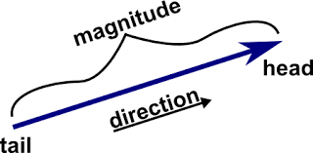
What is a Vector?
A vector is a quantity that has both magnitude and direction.
Represented as in 2D or in 3D
Used in physics, engineering, and computer graphics.

Slide 16
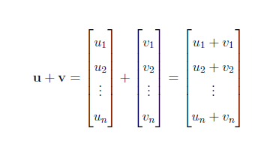
Vector Addition
When adding two vectors of the same dimension, we combine their corresponding components.
This can be visualized geometrically as placing the tail of the second vector at the head of the first vector; the resultant vector stretches from the tail of the first to the head of the second.
Mathematically:
u + v = [u₁, u₂, ..., uₙ] + [v₁, v₂, ..., vₙ] = [u₁+v₁, u₂+v₂, ..., uₙ+vₙ]

Slide 17
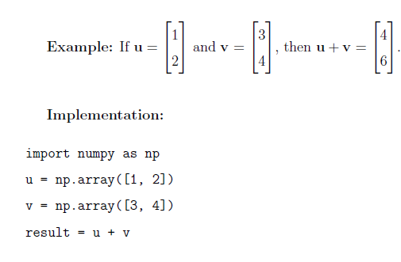
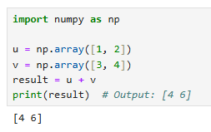
Vector Addition
Implementation:

Slide 18
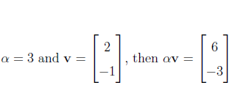
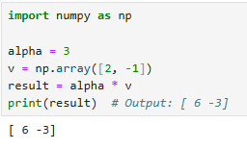
Scalar Multiplication
Scalar multiplication involves multiplying a vector by a single number (a scalar). This has the effect of scaling the vector's magnitude (length). If the scalar is positive, the direction remains the same; if negative, the direction is reversed.
Mathematically: αv = α[v₁, v₂, ..., vₙ] = [αv₁, αv₂, ..., αvₙ]
Implementation:

Slide 19
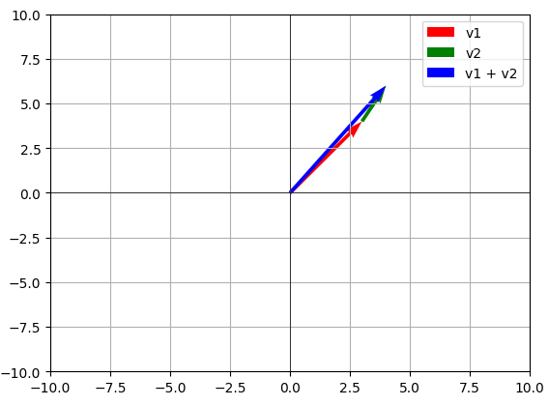
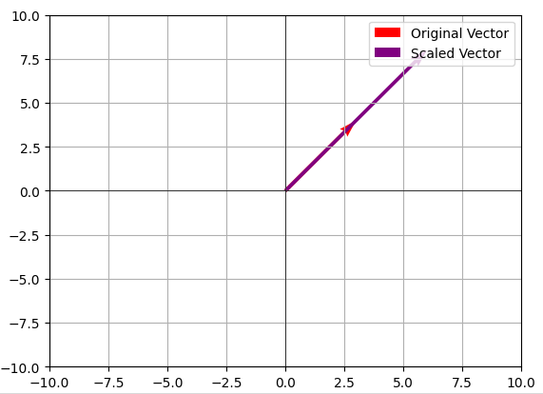
Visualization with Python
Vector Addition | Scalar Multiplication

Slide 20

Practical Implementation
Click here for the Code

Slide 21

















الشراكات العالمية

Slide 22
شــــــكــــرًا لكــــــم
THANK YOU

